Slide 1
Restaurant Competitive Landscape in Toronto
Market Segmentation

Slide 2
Introduction
Background
The Toronto food scene is vibrant and diverse
Over 15,000 restaurants
Employs: 64,000 Wages: ~$3B
Problem
Covid-19 putting strain on the restaurant market. Many risk folding
Understanding competitive landscape more important than ever as demand dries up
Interest
Allow restaurants to better differentiate by gauging market concentration
Allow municipality to better allocate relief by target troubled groups

Slide 3
Data
Retrieve relevant data on restaurant characteristics
Address
Labels (pizza, sushi, patio, etc)
Price point
Description
Scraped from NOW Toronto (online catalog):
Address, labels, description
Foursquare:
Called price points for subset of 300 restaurantsm

Slide 4
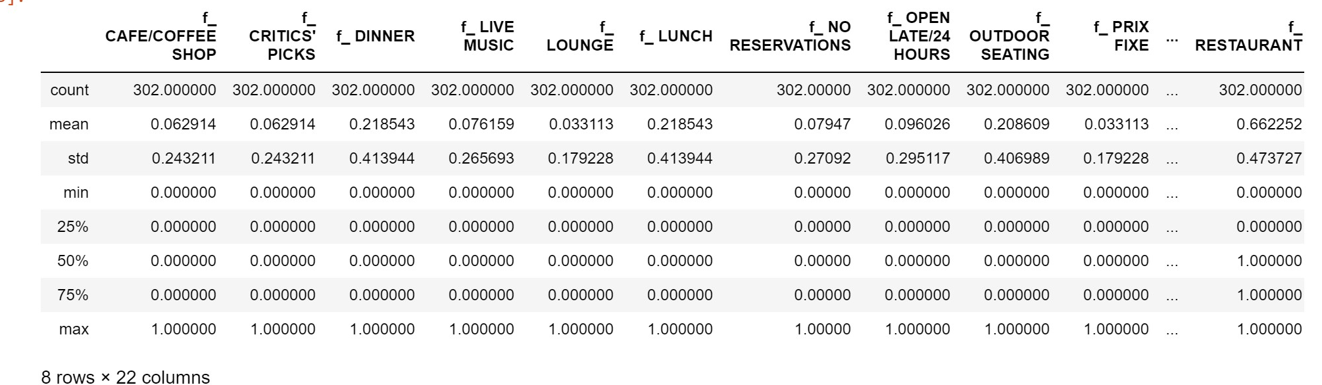
Dummies
Most of our features are categorical. In order to pass them to our clustering algorithm, we have encoded them as dummies (one hot).
Irrelevant dummies (dummies relevant to <10 restaurants) were dropped to avoid overfitting.
Feature set includes 22 features, ~300 records

Slide 5
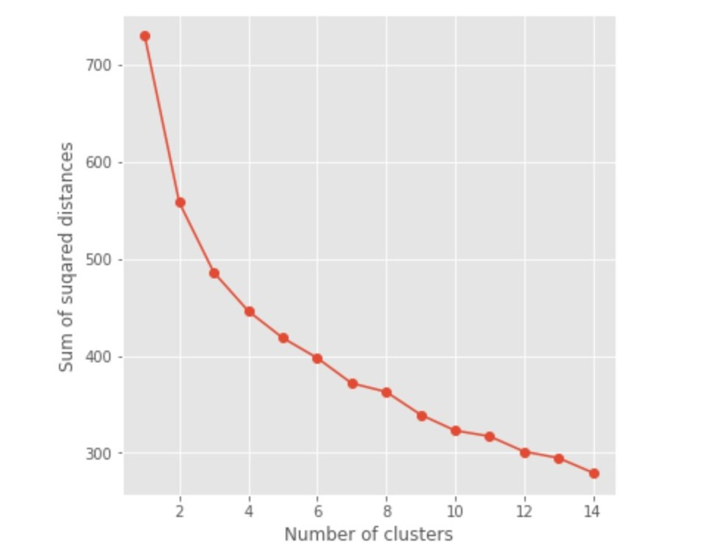
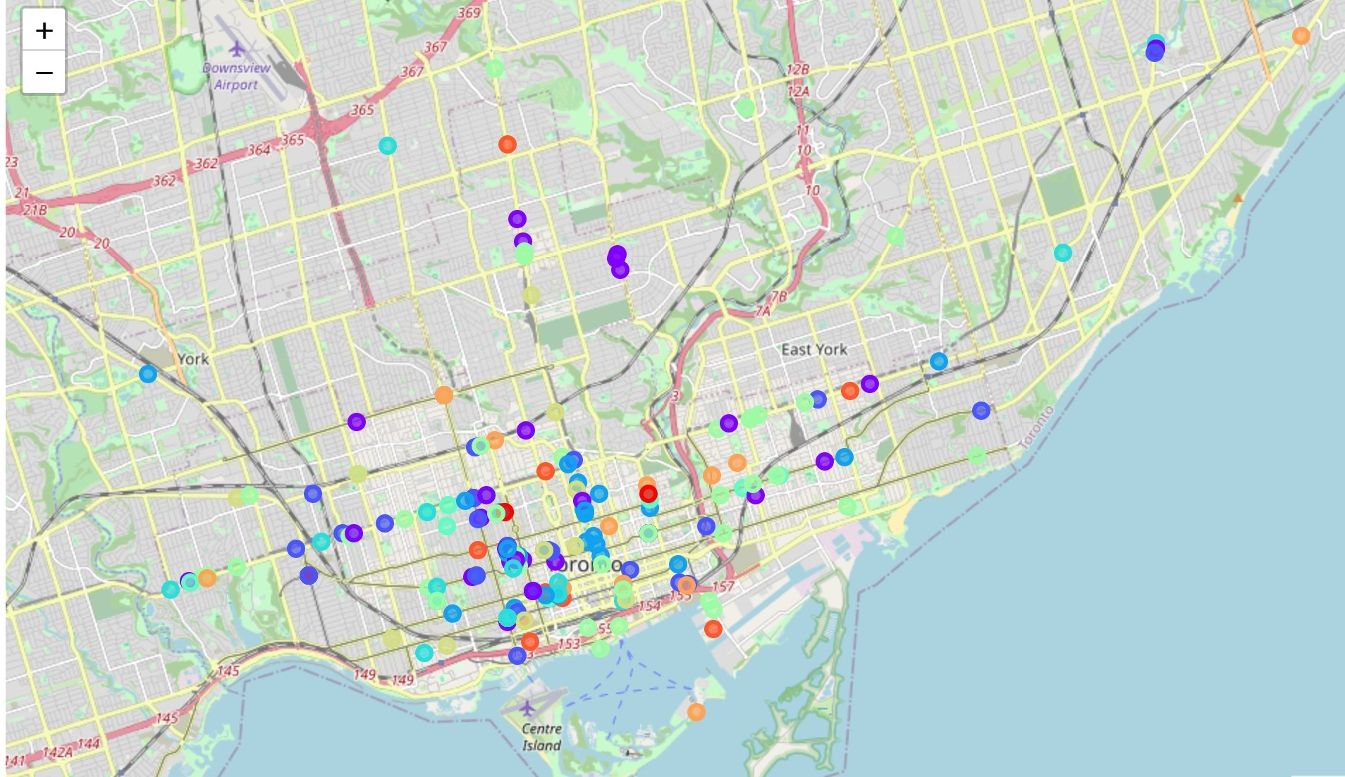
Model
K-means algorithm was used to cluster restaurants
Number of clusters = 10
More or less randomly distributed geographically

Slide 6
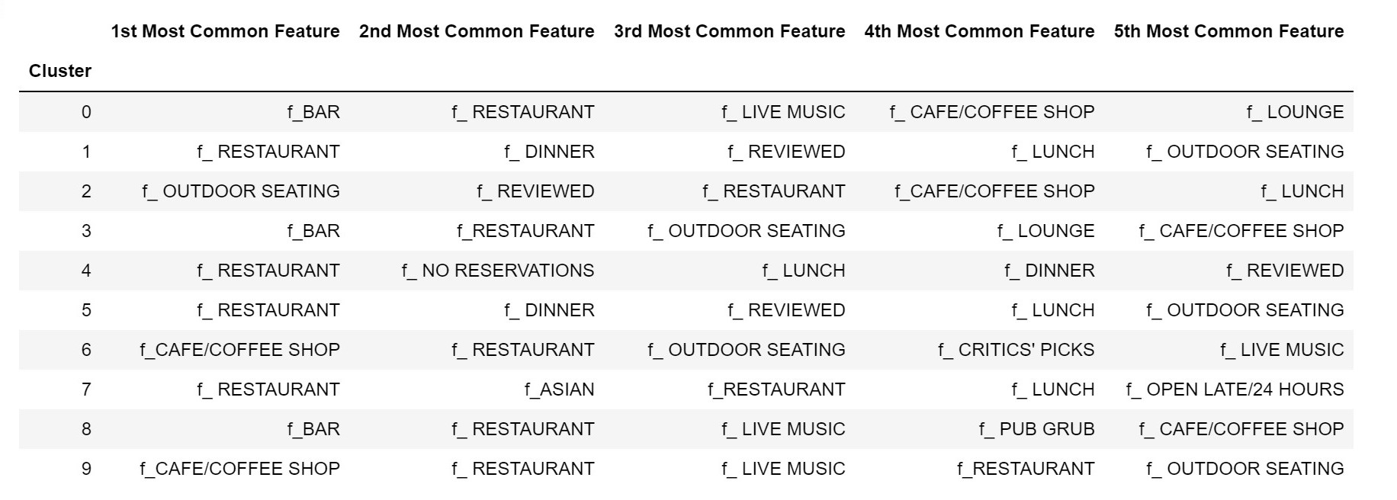
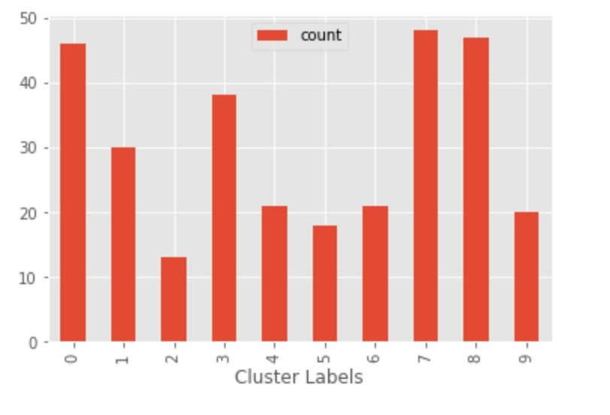
Clusters

Slide 7
Conclusion
There are roughly 10 distinct segments in the Toronto restaurant market
The largest segments seem to be:
Asian restaurants
Bars/Pubs
Restaurant clusters seem to be randomly distributed throughout the city (signalling a general diversity).

Slide 8
Future Directions
More and better data
There are many dimensions to any given restaurant which were not captured by our data
This study only examined 300 of the 15,000 restaurants in Toronto. A larger subset would allow for a more in depth study of geographic concentrations (i.e where do certain kinds of restaurants tend to be located).

